Slide 1
Machine Learning meets DevOPS: Paying DOWN the high interest credit card
Sameer Wadkar, Senior Principal Architect
Nabeel Sarwar, Machine Learning Engineer
1 May, 2018

Slide 2

Introduction and background
Customer Experience Team
27 Million customers (High Speed Data, Video, Voice, Home security, Mobile)
Ingesting about 2 Billion Events / Month
High-volume OF Machine-generated events
Data SCIENCE Pipeline
Grew from a few dozen to 150+ data sources / feeds in about a year
Comcast collects, stores, and uses all data in accordance with our privacy disclosures to users and applicable laws.

Slide 3


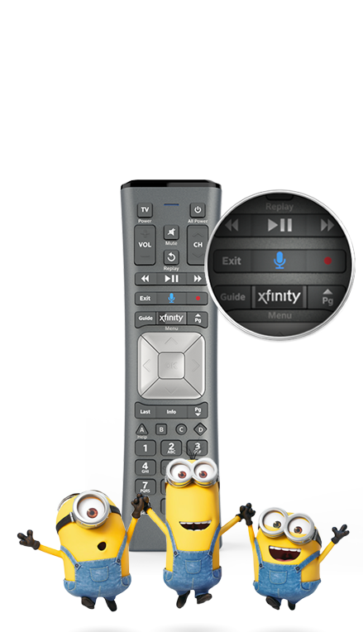
Comcast Applied AI
Media &
Video Analytics
High Speed Internet
Universal Parks
Video
Customer Service
Home Security / Automation
Media Properties
Machine Learning
& Data Science
Speech & NLP
Content Discovery
Notes:
Universal Parks – Recommendation engines
Video, Media Properties – Metadata for shows

Slide 4

Business Problem
Increase positive Customer Experiences
Resolve potential issues correctly, quickly AND EVEN BETTER PROACTIVELY
Predict and Diagnose service trouble across multiple knowledge domains
Reduce Costs through earlier resolution and by reducing avoidable technician visits

Slide 5





AI for Customer service
Interactive
Predictive
Proactive
Notes:
How do we show this as an overall framework?
How can this be solved with reinforcement learning?
State of world / what did we do / what did we move, is the world better
Have the AI slide (user customer truckroll agent) – rearrange around reinformement learning concept, how they all fit in to the overall vision

Slide 6
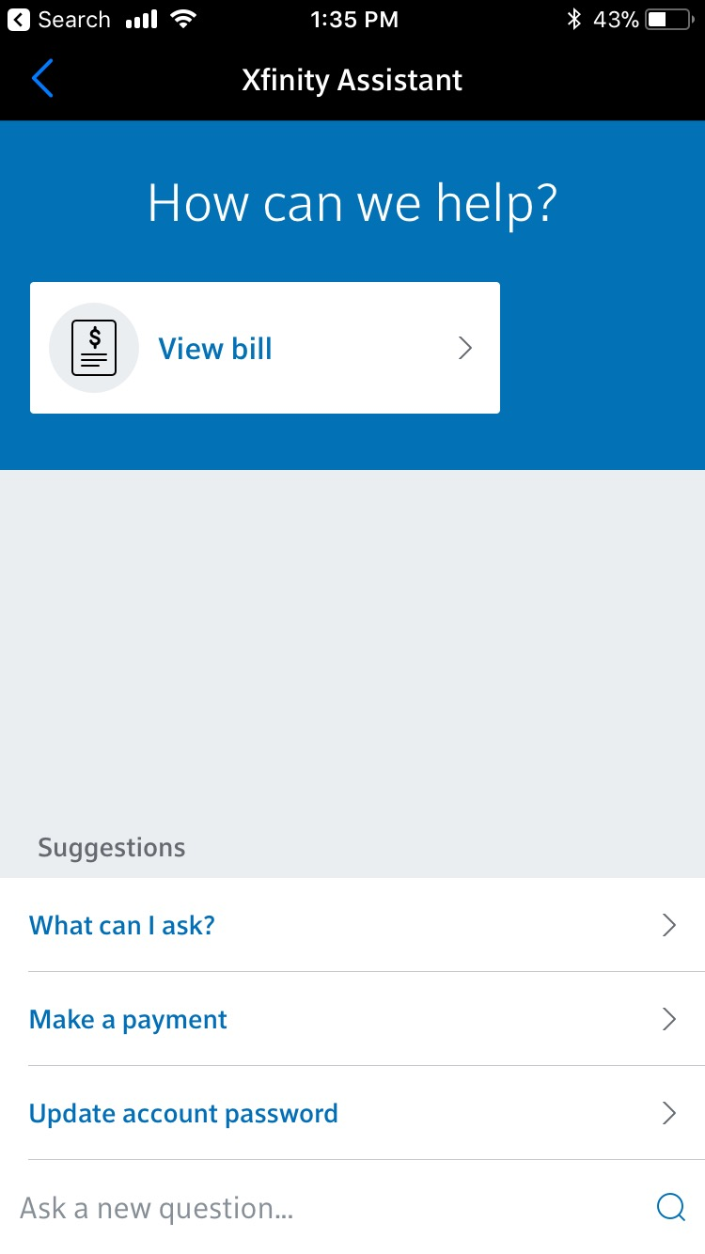
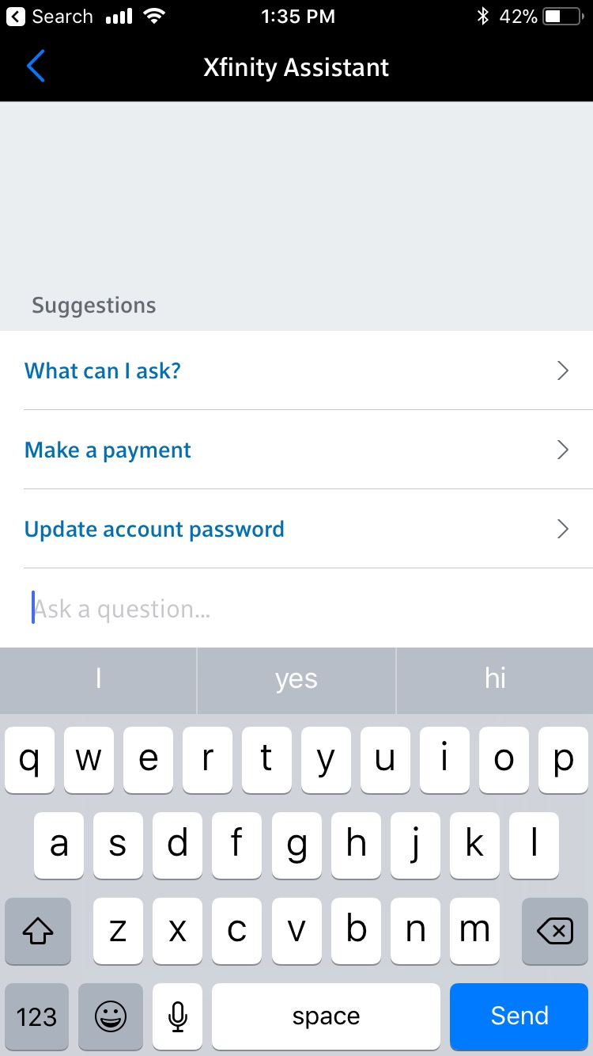
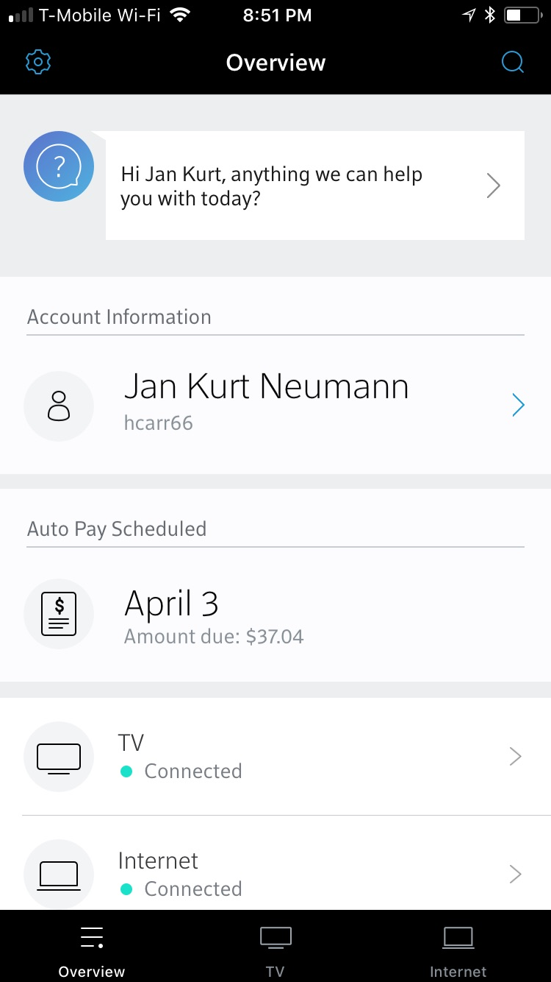
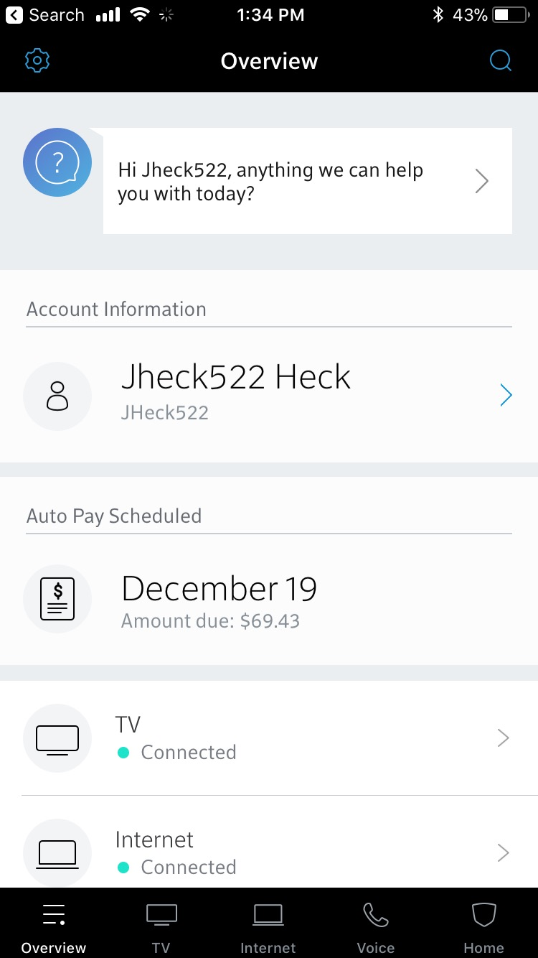
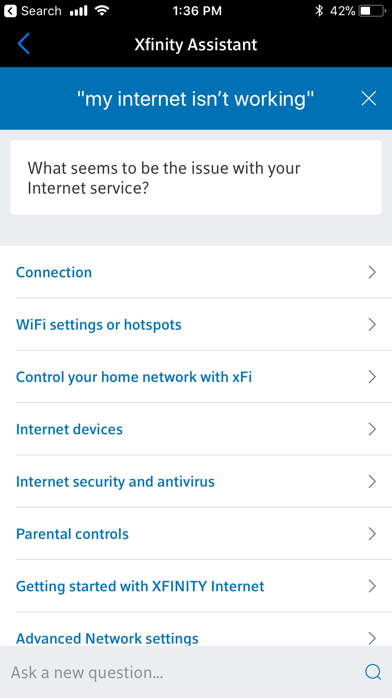
XFINITY Virtual Assistant
My Account Main Screen
XFINITY Assistant
Type a question
Disambiguate

Slide 7




Virtual Assistant – Step by Step
Interactive (Conversational) Actions
NLP
Customer intents
Notifications
Natural language
input and feedback
Agent Contact
Explore
Decision Engine
Action
Catalog
Domain models
Schedule Truck Roll
Choose Best
Predictive AI/ML
Predictive AI/ML
Predictive AI/ML
Context
Root Cause Predictions
Self-Heal
Devices, Applications, and Platforms instrumented to provide telemetry
Proactive (Automatic) Actions

Slide 8
Virtual Assistant – Interactive flow
Interactive (Conversational) Actions
NLP
Customer intents
Notifications
Natural language
input and feedback
Agent Contact
Explore
Decision Engine
Action
Catalog
Domain models
Schedule Truck Roll
Choose Best
Predictive AI/ML
Predictive AI/ML
Predictive AI/ML
Context
Root Cause Predictions
Self-Heal
Devices, Applications, and Platforms instrumented to provide telemetry
Proactive (Automatic) Actions

Slide 9
Technical Problem
Multiple Programming and Data Science Environments
Widespread and Discordant Data Sources
The “Data Plane” Problem: combining Data at Rest and Data In Motion
Consistent feature engineering
ML Versioning: Data, Code, Features, Models

Slide 10

Example near real time prediction Use Case
Customer runs a “speed test”
Event triggers a prediction flow
Enrich with network health and other indicators
Execute ML model
Predict whether it is a wifi, modem, or network issue

Slide 11

REINFORCEMENT LEARNING USE CASE
WIFI quality
Say quality drops every Saturday at ~6pm
"Reboot your box please"
"Reboot your box please"
"Reboot your box please"
Weeks
ML Based decision engine needs to learn that rebooting the box is unlikely to help
INPUT: CURRENT STATE OF THE CUSTOMER
OUTPUT: REBOOT Action FAILED
IT DID NOT HELP THE LAST N TIMES, REWARD PREDICTION IS LOW

Slide 12
SPACE CORRELATION EXAMPLE
Green = Works
Yellow = Has Problems
Cable
Likely failure
ML Algorithm needs to learn that there is no need to send 3 repair trucks
LOGS from which training datasets are sourced show correlation between unsuccessful truck dispatches and concentrated cable failures
GEO-LOCATION is available in the customer context
Algorithm can cluster customers based on GEO-LOCATION

Slide 13
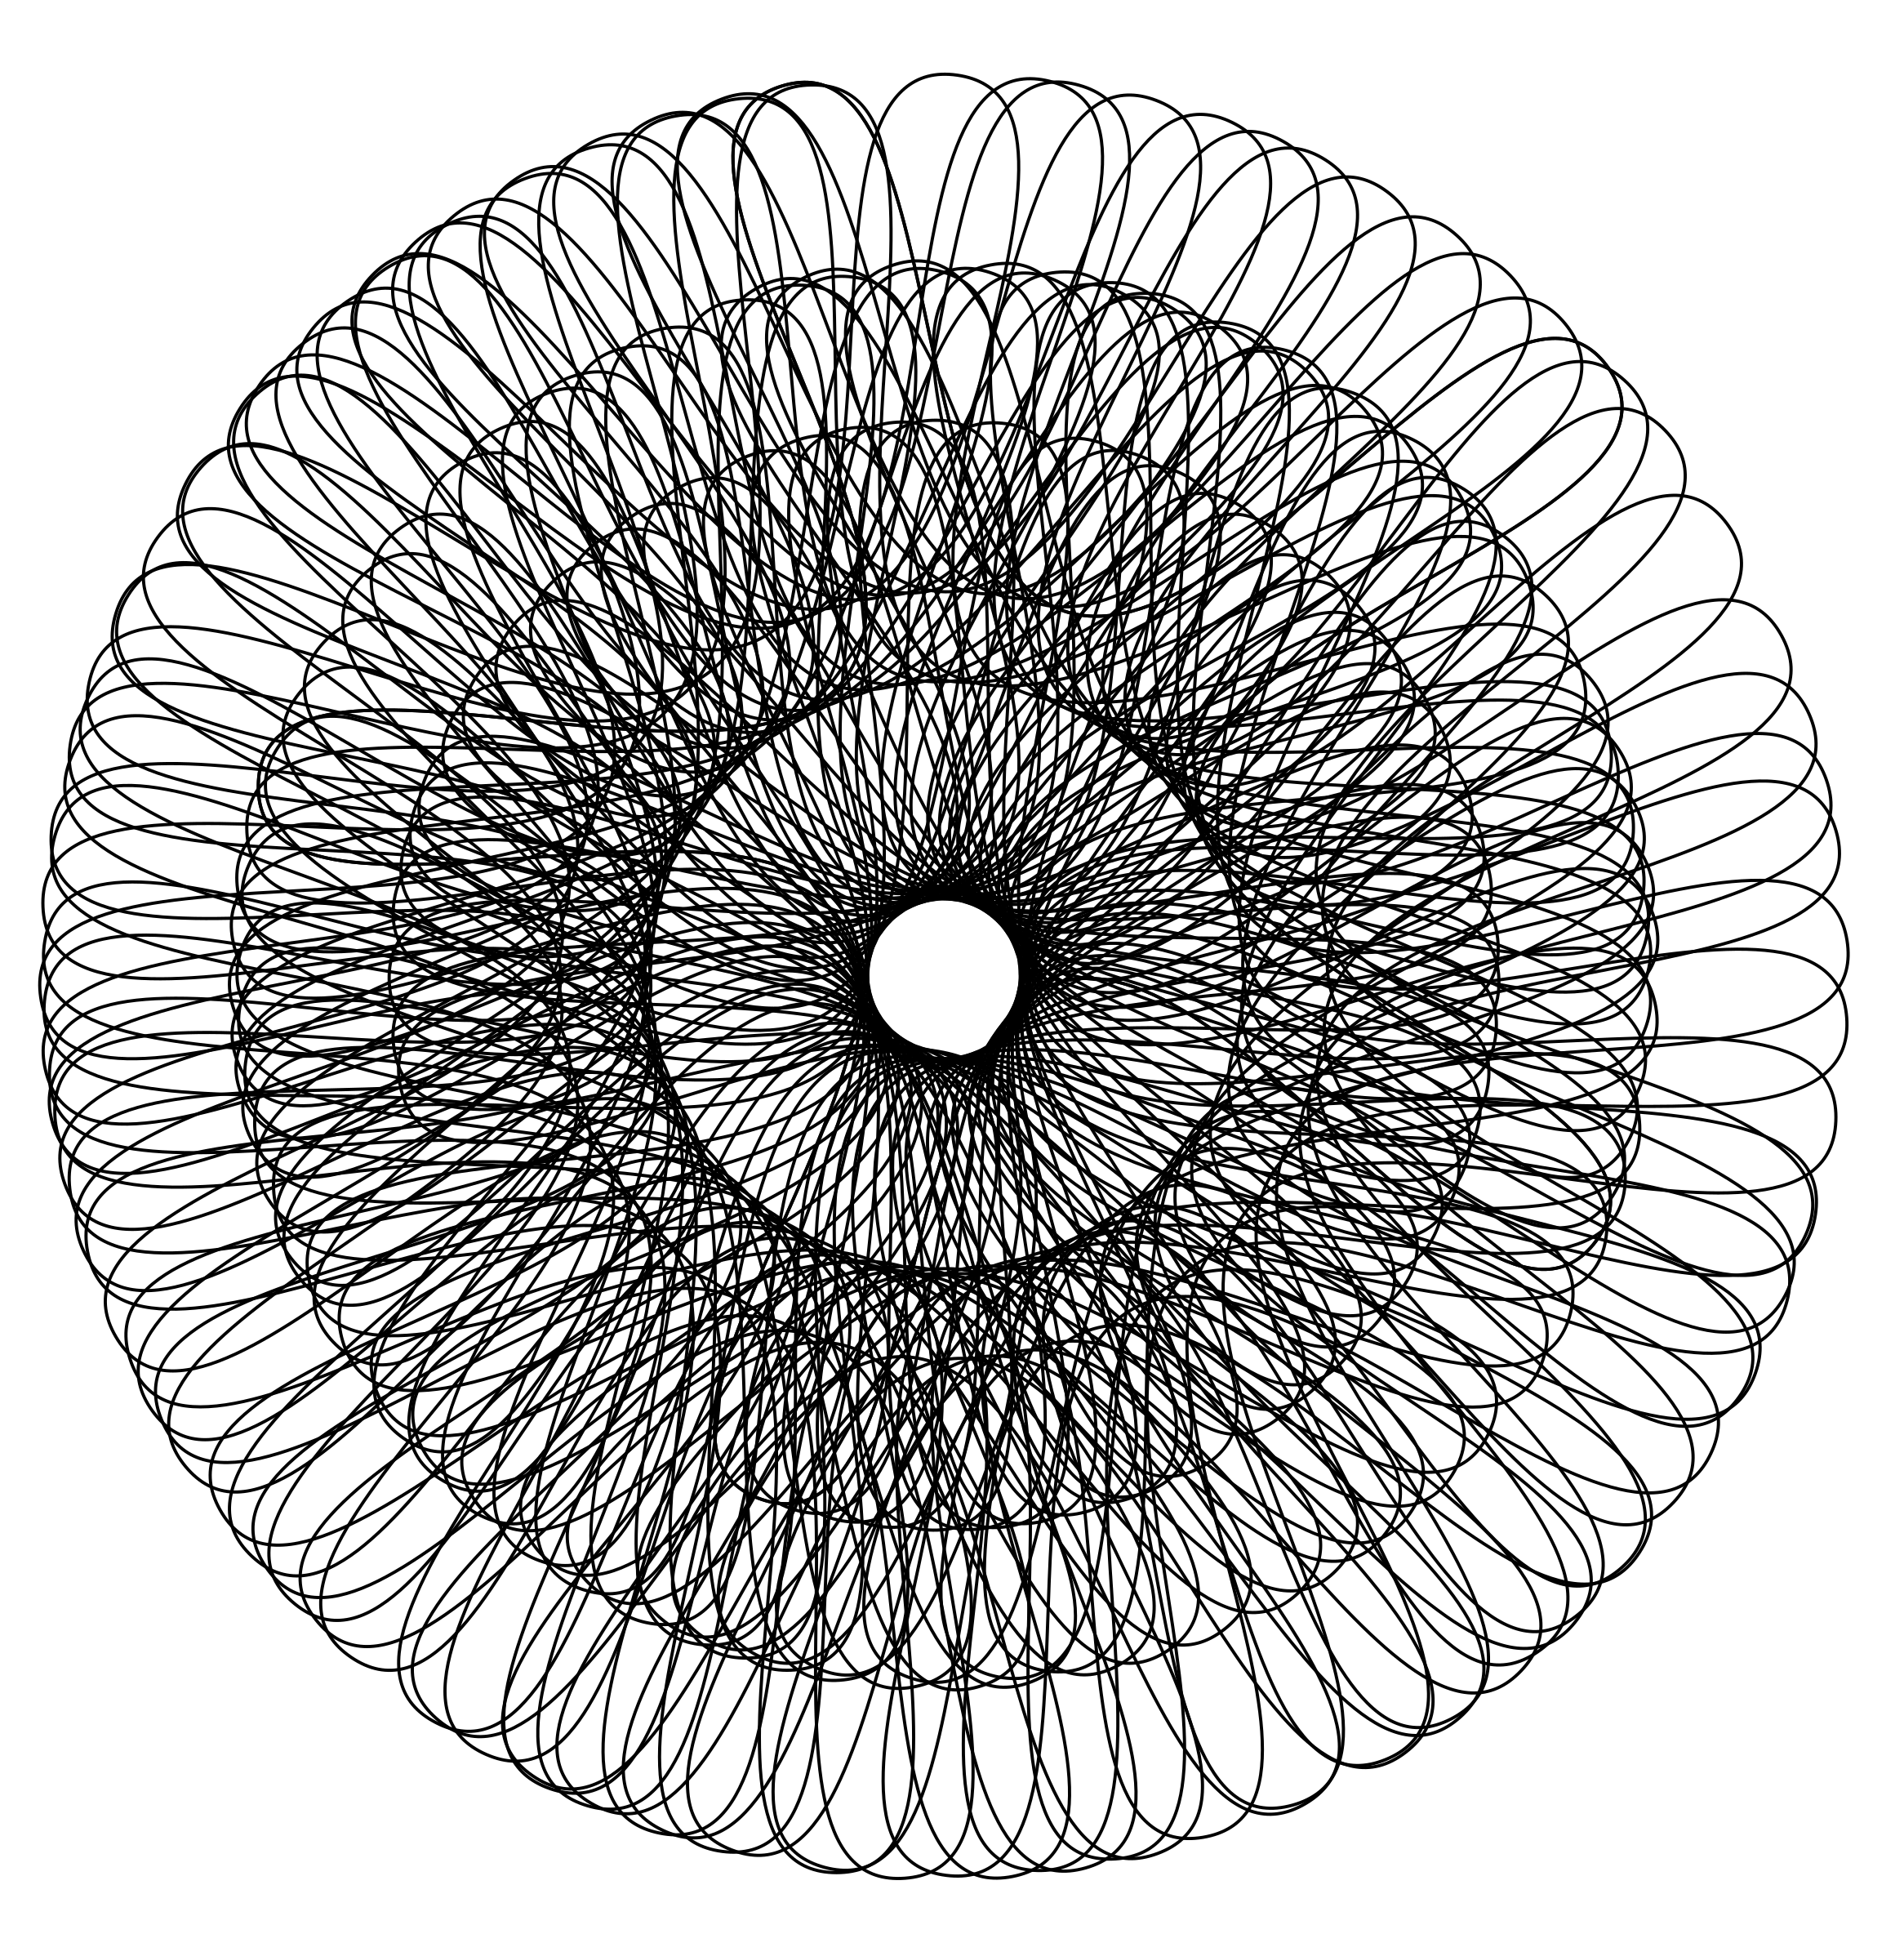
CHALLENGE- STANDARDIZATION OF FEATUREs
Two main challenges
feature assembly (Enrichment) during prediction time
Discovering correlations when we have 25 million customers and use 10 products each
We need a standardization of features, actions and rewards
FEATURE STORE – CURATED DATA STORE to drive model training and model prediction

Slide 14



ML Pipeline – Roles & Workflow
Inception
Exploration
Model Development
Candidate Model Selection
Model Operationalization
Model Evaluation
Go Live Phase
Define Use Case
Model Review
Model Selection
Evaluate Live Model Performance
Go Live with Selected Models
Business User
Iterate
Explore Features
Create & Validate Models
Monitor Live Models
Collect new data & retrain
Data Scientist
Iterate
Define Online Feature Assembly
Define pipeline to collect outcomes
Model Deployment and Monitoring
Create and publish new features
ML Operations

Slide 15

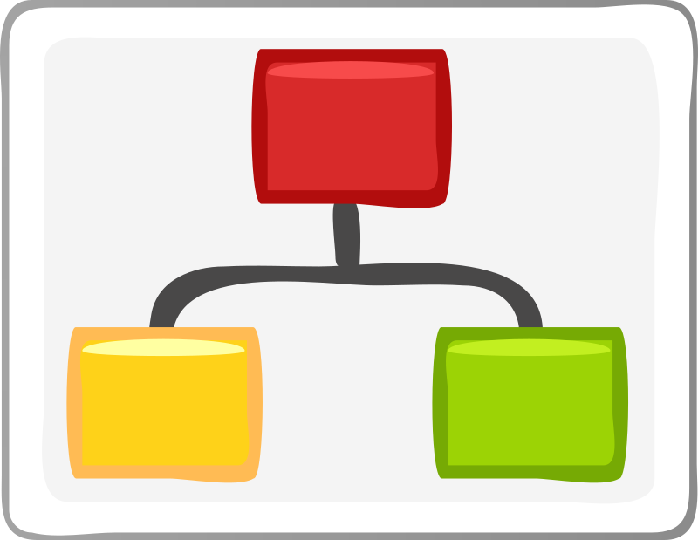


Solution Motivation
Self-Service Platform
Models Treated as Code
Align Data Scientists and Production
High Throughput Stream Platform

Slide 16
Feature Store
Two types of Feature Stores:
  Online Feature Store – Current values by key (Key/Value Store)
  History Feature Store – Append features as they are collected (Ex. Hadoop File System, AWS S3)
Online feature store
  Used in the prediction phase for enrichment
  Needs to support fast ingest and query as it stores current data for given account or account & device combination
History feature store
  Used to build history of features
  Data Scientist use this store to create their training datasets
Feature Creation Pipeline
Overwrite
Append
Online Feature Store
History Feature Store
Prediction Phase
Model Training Phase
Notes:
What is an XRE error?

Slide 17


Using the Online feature store
1. Payload only contains Model Name & Account Number
4. Pass full set of assembled features for model execution
Model Execution Trigger
Feature Assembly
Model Execution
5. Prediction
2. Model Metadata informs which features are needed for a model
Model Metadata
Online Feature Store
3. Pull required features by account number
Notes:
What is an XRE error?

Slide 18


Feature creation pipeline
Online Feature Store
Two Types:
  Continuous Aggregations on streaming data.
  On Demand Features
Aggregation feature examples
  Number of customer calls in the past 30 days. Key = Account Number
  Number of signal errors > 2000 in a 24 hour tumbling window. Key= Account Number + Device Id
On Demand Feature Example
  Diagnostic telemetry information for each device for a given customer
  Expensive to collect. Only requested on demand
  Model Metadata specified TTL for such a feature
Feature Assembly
Model Metadata
Continuous Stream
On Demand Feature Request
Aggregation Pipeline
On Demand Pipeline
External Rest API
Feature Writer
Feature Metadata
Online Feature Store
History Feature Store
Notes:
What is an XRE error?

Slide 19
Feature METADATA
Key: Namespace, Name & Version
How do I identify a feature?
Online Feature Store Key Definitions: JSON Path & Script References (Code & Method) in GITHUB
How I identify a specific instance of a FEATURE
Historical Feature Store Key Definitions: JSON PATH to extract Identifiers, Connection PARAMETERS to HISTORY STORE, SCRIPT & JSON PATH to extract Partitions
How do I WRITE to a history store(s)?
UPDATE TS EXTRACTORS : Combination of JSON PATHS, SCRIPT REFERENCES to extract TIMESTAMP from FEATURE PAYLOADS
What is the update time stamps for each feature value? EVENT vs. INGESTION TIME
Notes:
What is an XRE error?

Slide 20
Example Feature VALUE
HEADER: TIMESTAMP, INTERNAL CUSTOMER IDENTIFIER
PAYLOAD: JSON Payload (Ex. SPEED TEST DATA)
Notes:
What is an XRE error?

Slide 21

INGEST FEATURE VALUE
HEADER: TIMESTAMP, INTERNAL CUSTOMER IDENTIFIER
PAYLOAD: JSON Payload (Ex. SPEED TEST DATA)
Feature MeTADATA
Feature INGESTION PIPELINE
Scripts Repository
Online Feature Store
History Feature Store
Notes:
S3 key for a feature:
{S3_BUCKET}/{namespace}/{name}/{version}/{SALT_0_to_99}/year={year}/month={month}/day={day}/

Slide 22
ONBOARD MODELS/FEATURES WITHOUT REDEPLOYMENT – SCRIPTING SUPPORT
SCRIPTING SUPPORT ENABLES ONBOARDING WITHOUT REDEPLOYMENT
  JSON Path, Jython, Java8 Nashorn
  Onboard Features, Define Models without ML Pipeline redeployment
  Separate platform features (Compiled JAVA Code) from Features/Model onboarding (Scripting)
Notes:
What is an XRE error?

Slide 23
Model METADATA
Key: USECASE, Name & Version
How do I identify a MODEL?
ENVIRONMENT PARAMETERS
DEFINE ENVIRONMENT PARAMETERS FOR MODEL EXECUTION
PER FEATURE DEFINITION: PRE-FEATURE ENGINNERING HOOKS, ATTRIBUTE LEVEL FEATURE ENGINEERING HOOKS, POST-FEATURE ENGINEERING HOOKS, TTL
CONSISTENT FEATURE ENGINEERING (SCRIPTS). WHY?
MODEL DEPLOYMENT DEFINITIONS
HOW IS THE MODEL DEPLOYED? AUTOSCALING DEFINITIONS
Notes:
What is an XRE error?

Slide 24
Consistent feature engineering - Model metadata
Model Metadata
Online Feature Store
Feature engineering must be consistent:
  Training
  Prediction Phase
Metadata driven
  Using configured scripts just like feature metadata
  Define features used
  Create engineered features from raw features using scripts (Jython, Nashorn)
  Ex. dsBad(map,env) – boolean to define bad speed test when download speed is lower than a threshold
  Define hyper-parameters in model metadata (ex. Scaling parameters during prediction and training parameters during training phase)
  Define TTL per feature (Prediction Phase)
Reference
Feature
Engineering
Scripts
Scripts Repository
Prediction
History Feature Store
Training
Feature Engineering (Jython/Nashorn)
Training/Testing/Validation Dataset record for training phase
Input record for the model during prediction phase
Notes:
What is an XRE error?

Slide 25
Consistent feature engineering - Model metadata
Scripts defined in MODEL metadata Are defined by Data scientist
  Used for creating training/testing/validation datasets from raw features. Apply on a record of data used for training or during prediction
  Also used at prediction time to perform real time feature engineering
Notes:
What is an XRE error?

Slide 26
Model deployment
Model as code
  H20 AI Pojo
  Spark ML Models
  Simple Python Scripts – Regression Models
  Specialized Python Scripts – Math libraries and need specialized hardware like GPU support
One model multiple deployment models
  Deployed as Docker containers with REST Endpoints – Easy to test and used directly if request has all the features available
  Deployed as Map Operators within Streaming framework such as Spark & Flink
  Deployed a Lambda functions in AWS
Notes:
What is an XRE error?

Slide 27

Prediction Phase
Payload: Model Name + Account Number
Append store (Ex. S3, HDFS, Redshift) for use by Data Scientist for Model Training
Model /Feature Metadata
History Feature Store
Are All Features Current?
Feature Store API
No
Feature Assembly
Feature Creation Pipeline
Online Feature Store
Yes
Feature Assembly
Online Feature Store
Assemble Features for a given Model
Model Execution
Requesting Application
Customer Context
Listens
Prediction/Outcome Store
Notes:
Now let us talk about non-current features. Some features like number of signal errors per device/customer for every 24 hour period are collected continuously. These features are always current. The model execution framework uses what it is currently stored. There are other features like “Premise Health Test” or PHT which collects telemetry data about every device associated with an account. PHT data is expensive to collect. It is collected via making a external service call which takes between 30-60 seconds to execute. Collecting such data constantly would be drain on resources, both on the customer side as well as our infrastructure side. We only request such features on demand if the model needs it. But once we collect it we store it in the online feature store. The Model metadata can indicate its tolerance for each feature using a TTL per feature attribute. For example a Model A may indicate that its tolerance for PHT data is 72 hours old. Model B may indicate its tolerance for the same PHT data is 24 hours old. If the Model A executes and sees PHT data which is 48 hours old, it will use it and not request a feature refresh. Model B on the other hand will consider this data old and request a feature refresh and invoke the feature creation pipeline by placing a “feature request” event on a queue.

Slide 28

Versioning and devops
Everything is versioned
  Feature/Model Metadata
  Feature Data & Model Execution environments
  Training, Validation datasets are versioned
  Feature creation pipelines are versioned
Versioning allows provenance & auditability & Repeatability of every prediction

Slide 29
Features of the ML Pipeline
Traceability & REPEATABILITY & Auditability
  Model to be traced back to business use-cases
  Full traceability from raw data to feature engineering to predictions
  “Everything Versioned” enables repeatability
CI/CD Support
  Code, Metadata (Hyper-Parameters) and Data (Training/Validation Data) are versioned. Deployable artifacts to integrate with CI/CD Pipeline
AWS Agnostic
  Integrates with the AWS Cloud but not dependent on it
  Framework should be able to work in a non-AWS distributed environment with configuration (not code) changes

Slide 30
Features of the ML Pipeline (Cont.)
Pluggable (Data and Compute) Architecture
  De-coupled architecture based on message driven inter-component communication.
  Failure of an isolated component does not fail the entire platform
  Asynchronous behavior
  Micro-Services based design which supports independent deployment of components
Multi-deployment options
  Supports Throughput vs. Latency Tradeoffs- Process in stream/batch/on-demand
  Allows multiple versions of the same/different models to be compared with one another on live data
    A/B testing & Multivariate testing
    Live but dark deployments
  Supports integration of outcomes with predictions to measure production performance & support continuous model re-training

Slide 31

Next Steps and Future Work
UI Portal for
Model / Feature and metadata management
Containerization support for model execution phase
Workbench for Data Scientist
Continuous Model Monitoring
Knowledge sharing
  Promote Reusability : Users search for features by model as well as engineered features by raw features.
  Search features by their importance in models
  Real time model evaluation by comparing predictions with outcomes
Automating the retraining process
Support for multiple/Pluggable feature stores (SLA driven)

Slide 32
SUMMARY
Metadata Driven
Automation
Iterative/Consistent
Model Development
Rapid Onboarding
Data Consistency
Monitoring and Metrics
Feature/Model Definition, Versioning , Feature Assembly, Model Deployment, Model Monitoring is metadata driven
Orchestrated Deployment for new features and models
Multiple versions of the model can be developed iteratively while consuming from a consistent dataset (feature store), enables A/B & Multivariate Testing
Portal for Model and Feature Management as well Model Deployment
Feature store enforces a consistent data pipeline ensuring that the data used for training is functionally identical to the data used for predictions
Ability to execute & monitor multiple models in production to enable real-time metrics driven model selection

Slide 33
Thank You!

